Slide 1

How does the Performance of NBA Teams Differ between Home and Away Courts?
And what Factors Contribute to this?
Final Presentation Jack Rowlands

Slide 2

Homecourt Advantage (Home Team Advantage
It is a well-known fact that in the NBA, there is a homecourt advantage.
In this project, this advantage will be analysed in specific stats.
Finding the effect this advantage has will be beneficial, as it allows teams to strategize around important playoff games.
Additionally, there are believed to be many differing factors which impact this advantage such as attendance, refereeing, and whether it is in the regular season or in the Playoffs.
These factors will be analysed to find the actual impact they have.
Finding which factors impact this advantage will allow for teams to make changes to exaggerate or mitigate the advantage.

Slide 3

Dataset
The main dataset I am using was obtained from Kaggle contains majority of in game statistics separated into home and away teams from 2004-2020. Source: NBA Stats
However, this dataset lacked attendance and foul statistics.
Therefore, I merged it together with a dataset containing attendance statistics. Source: NBA API
I then made my own foul dataset out of a dataset containing details about every play in the game and merged that together. Source: Basketball Reference
I merged all the datasets together using the common team names and dates.

Slide 4

Methods
This merged dataset was then analysed using python to visualise using pandas, NumPy, matplotlib, and seaborn.
To see if the variables had a statistically significant effect on each other, multiple statistical tests were performed, depending on the category of variables.
Chi-Square – For categorical variables
Independent t-test – To compare means between two independent variables
Pearson Correlation – To find linear relationships between two variables.

Slide 5
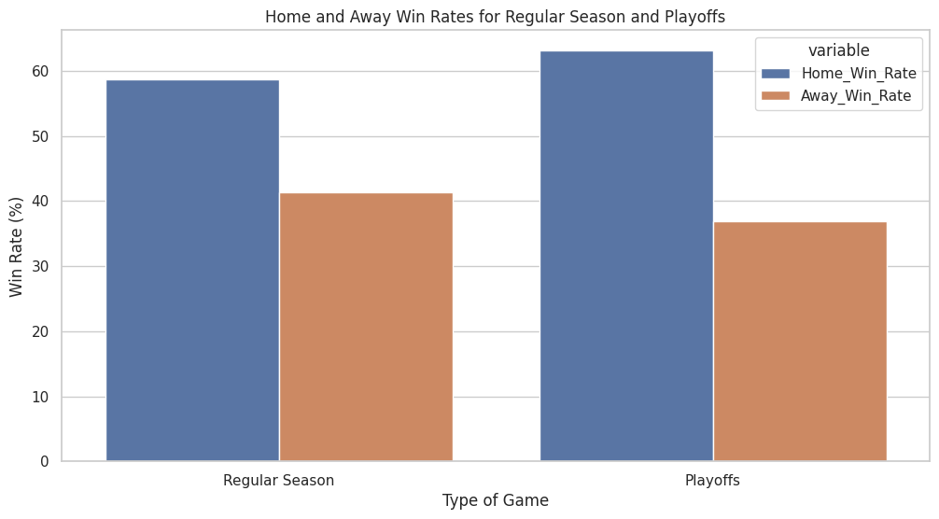
Home and Away Win Rates for Regular Season and Playoffs
The bar plot indicates that home teams have a higher win rate compared to away teams in both regular season and in Playoffs.
This effect is larger in the Playoffs.
This difference in win rates is statistically significant, with both p-values being many magnitudes below the typical alpha level.
Regular Season: p-value = 3.60E-69
Playoffs: p-value = 3.19E-11

Slide 6
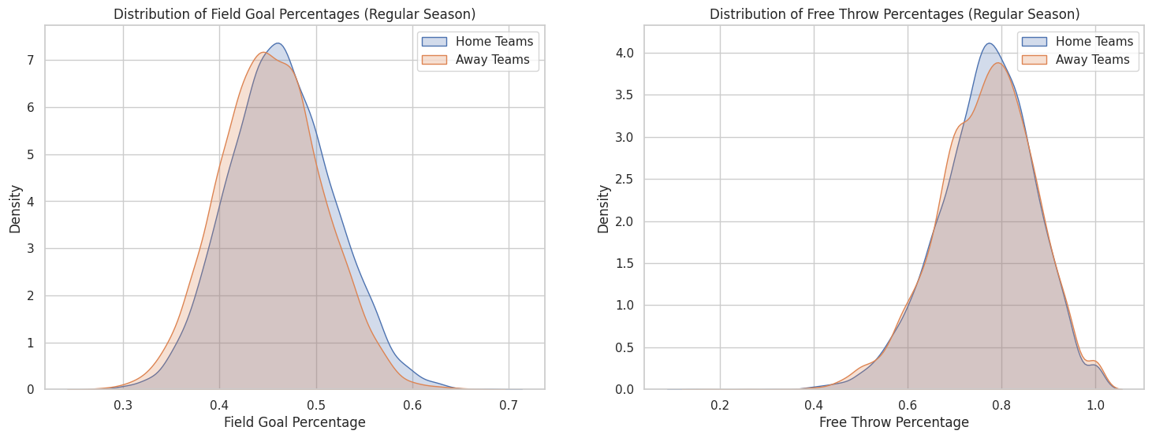
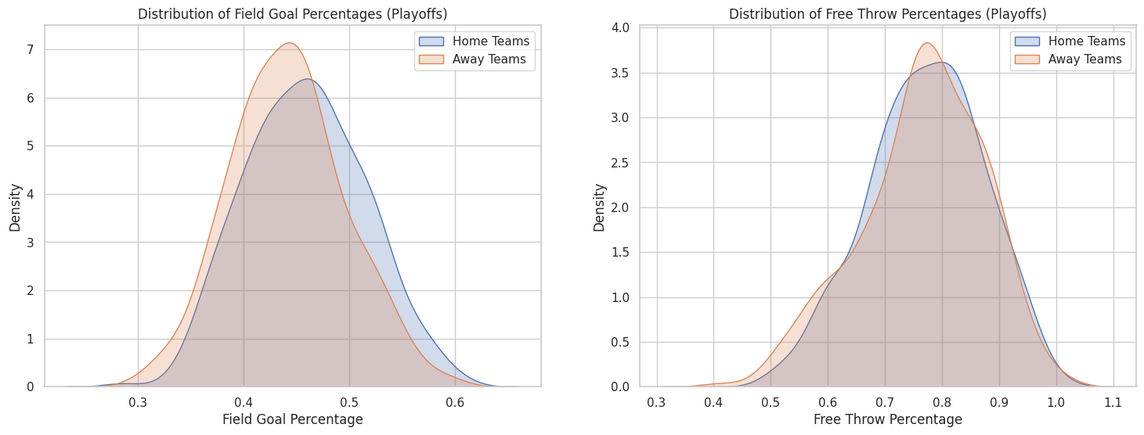
Shooting Percentages
Both home and away teams have similar field goal distributions, with a slightly higher peak for home.
The distributions for free throw percentages are highly similar between Home and Away teams in both regular season and Playoffs. The p-values for both are greater than the alpha level, suggesting the differences are not statistically significant. This contradicts the hypothesis made that this would be a factor impacted by homecourt advantage.

Slide 7
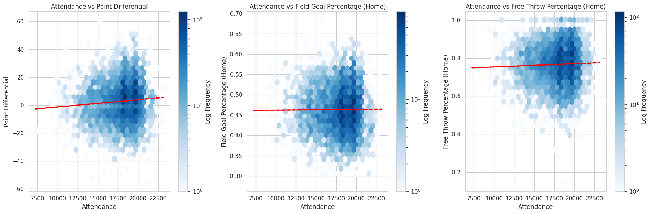
In-Game Statistics against Attendance
Slight but statistically significant positive correlation between attendance and point differential.
No statistically significant correlation with field goal percentage, shown with the straight trend line.
However, there is a statistically significant minor positive correlation between attendance and free throw percentage.

Slide 8
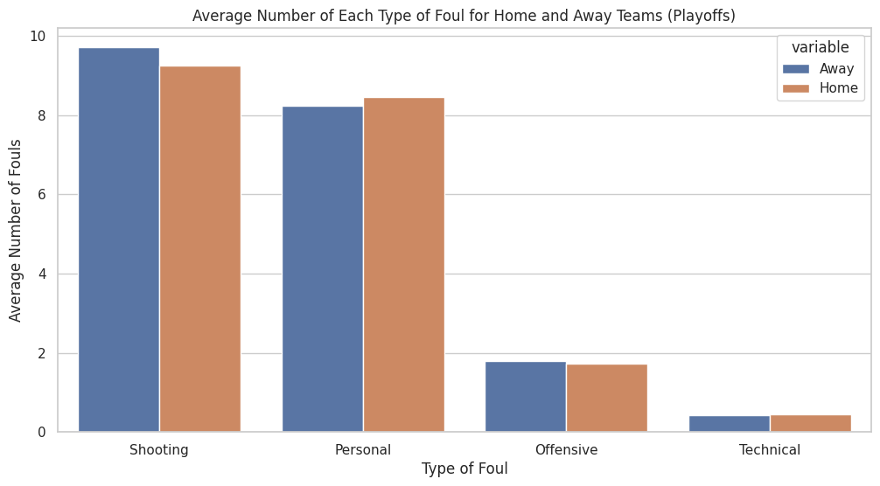
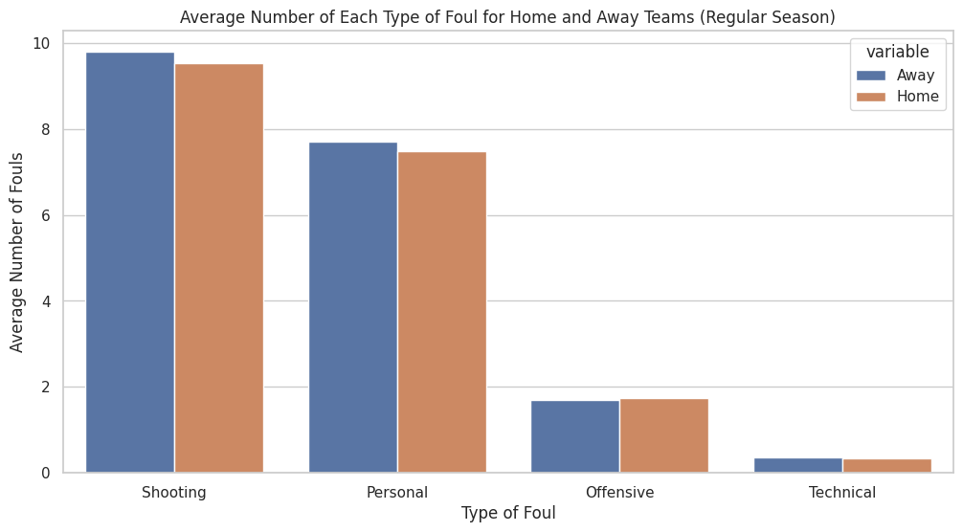
Fouls for Home vs Away Teams
There is a slight bias in shooting and personal against the away team in the regular season, being statistically significant.
There was no bias found in the offensive and technical fouls.
In the playoffs, there was no significant bias in personal fouls, however there was a bias found in shooting fouls.

Slide 9
Conclusion
Statistically significant higher win rates for home teams in both regular season and playoffs. Teams should focus on securing homecourt advantage during critical playoff games.
Field goal percentages are affected by homecourt advantage unlike free throws, indicating teams must practice field goals under pressure.
There's a weak yet statistically significant link between attendance and point differential.
Statistically significant differences in the number of fouls against away teams in the regular season, indicating bias.
Some additional steps could be to research individual players/teams.
Homecourt advantage is more than a myth, it holds statistical significance with factors like win rates and foul calls. This advantage grows even stronger in the high-stakes playoffs.

